Slide 1

Employment and Social Affairs Platform
This project is funded by the EU

Slide 2
Main regional initiatives under RCC auspices
SEE 2020 Strategy – Jobs and prosperity in a European Perspective
Inclusive growth is one of the main pillars of the strategy and employment and health, key dimensions of it.
By 2020, the region has committed to achieve 11 ambitious headline targets, including the creation of 1 million new jobs

Slide 3
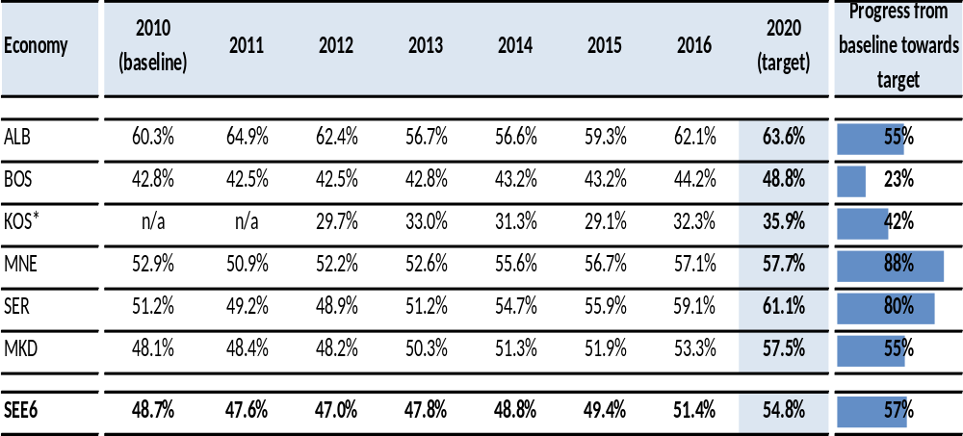
SEE 2020 Target 10 – Employment rate, age group 20-64

Slide 4
Main regional initiatives under RCC auspices
2. Multi-Annual Action Plan on Regional Economic Area
  Further trade integration;
  WB dynamic regional investment space;
  Facilitated regional mobility, strengthened R&D and innovation base;
  WB Digital integration agenda-digitalize WB societies and businesses.

Slide 5
Employment and Social Affairs Platform (ESAP)
Implementation period: March 2016- March 2019
Implementing institutions: RCC and ILO
Overall objective: strengthen regional cooperation and institutional capacities of national administrations, employers’ and workers’ organizations, enabling them to develop and effectively implement labour market and social policy reforms in their EU enlargement process.

Slide 6
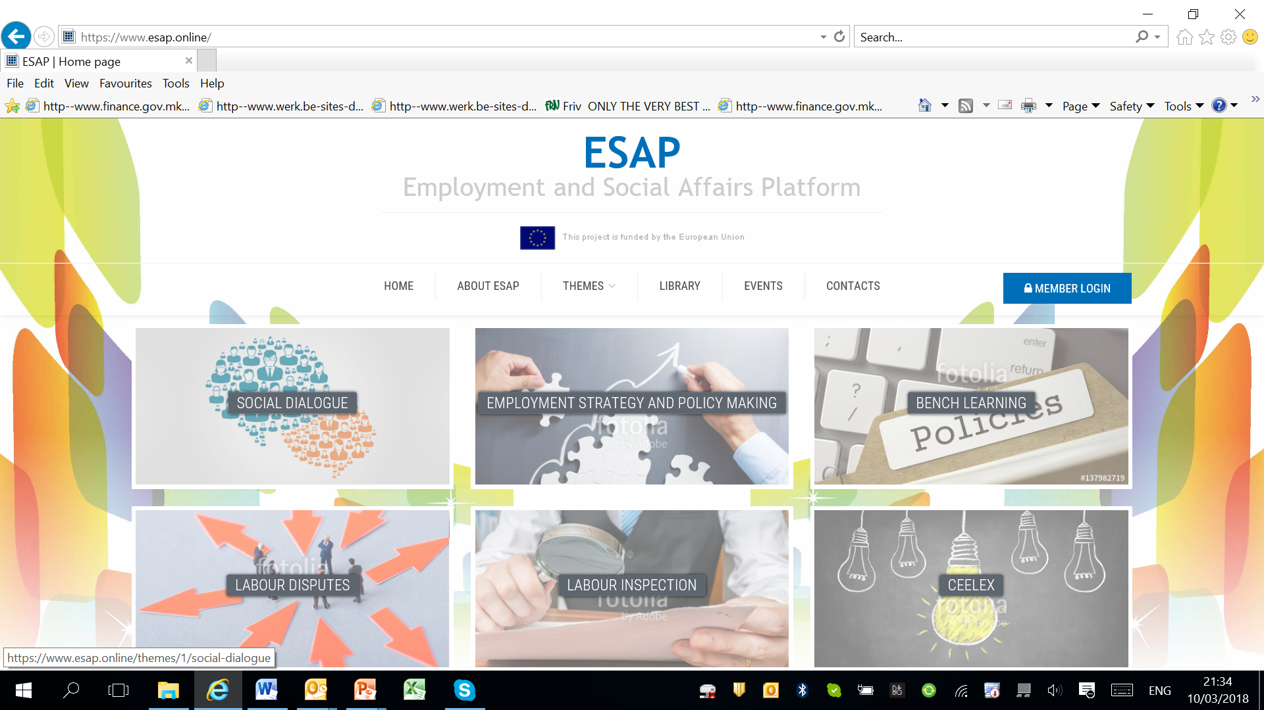

Slide 7
Specific RCC Objectives
1. Enhance regional cooperation and establishing of a structured regional Employment and Social Affairs Platform: www.esap.online
Analytical work:
  A comparative report on performance management in public employment offices in the Western Balkans
  A regional analysis of employment and social measures in the Western Balkans
  An analysis of employment and social data sources in the Western Balkan region
  Western Balkans labour market analysis, 2010 – 2016
  Forecasting employment patterns in the Western Balkans
Regional database on labour market indicators (based on national data and the quantitative benchlearning assessment)

Slide 8
Specific RCC Objectives
2. Support the processes and enhance the capacities of administrations for preparation, monitoring and follow up of employment and social measures
Peer reviews on employment policies and programmes
Technical assistance on national priority needs

Slide 9
Peer reviews on employment policies/programmes
Aim: facilitate learning, discussion and capacity building on policy development and implementation in the domain of employment and social affairs
In-depth assessment of an employment policy in one economy by representatives of other economies from the Western Balkans, with the goal of providing feedback to the host institution to improve its performance within that policy field

Slide 10
Peer review topics
Western Balkan Economy | Selected Topic
Albania | On the job training programmes for youth with no qualifications
BiH | Local employment partnerships
Kosovo* | Self-employment programmes
Montenegro | Youth employment
Serbia | Employment of persons with disabilities
The Former Yugoslav Republic of Macedonia | Internship programme

Slide 11
Peer review design
Host country in depth thematic review
Peer country overviews
Peer review workshop
Peer review follow-up paper

Slide 12
ESAP Technical Assistance
hands-on short term expertise to support the national employment, labour market and social affairs strategies, action plans and/or measures
support to organisation of national trainings, workshops, conferences or other activities

Slide 13
Examples of TA use
ESRP conference in Skopje, Feb 2017
Tripartite Working Group on Labour Code Reform, Montenegro, May 2017
Support the establishment of the new Integrated Information System in the Ministry of Labour and Social Welfare, Kosovo*, 2017
Legal analysis of vocational training centers in Kosovo*, 2017
Developing rules of procedure for the advisory board of the newly established Employment Agency in Kosovo*, 2018
Support to the upgrade of the IT system of the Montenegrin Employment Agency in line with EURES requirements, 2018
Developing a monitoring framework for the youth employment action plan 2018-2020, Kosovo*, 2018

Slide 14
Specific RCC Objectives
3. Strengthen the capacities of Public Employment Services (PES) to facilitate the SEE 2020 labour mobility objective and prepare for future participation in the European Employment Services
Benchlearning initiative – establishing a link between benchmarking and mutual learning activities
  Support reflection on PES performance in systematic way
  Identify development needs -> basis for mutual learning activities

Slide 15
PES Benchlearning Cycle
PES-Report
Mutual Learning
National Action
Plan
Improved Outcome
Quantitative and Qualitative Assessment
Areas of Improvement
Implementation of Change
Good Practices

Slide 16
Assessment Process
Quantitative Assessment
Data collection and analysis
Qualitative Assessment
Identify unquantifiable strengths and good practices
Database
with data of each national PES
PES-Self Assessment
External PES Assessment
Overall PES-Benchmarking comparative statistics
Valid Performance Outcomes
True Performance Enabler
Evidence-based Good Practices
Mutual Learning Process

Slide 17
Assessment Framework on Benchlearning
Performance drivers/ enablers
Results
Labour market conditions
Strategic
PES management
Design of operational processes and use of information
Evidence-based design and implementation of PES services
Iden-tify & implement reform
Output and outcome of PES
Learning
B
E
A
H
Sustainable activation and management of transition
Effective management of partnerships and stakeholders
C
F
Institutional conditions
Relations to employers
Allocation of PES resources
D
G
Context
Variables/
Background
Qualitative Assessment of Performance Enablers/
Self-Assessment
Bench-marking indicators
Mutual Learning
Activities
Integrated Benchlearning Concept based on EFQM-Excellence Model

Slide 18
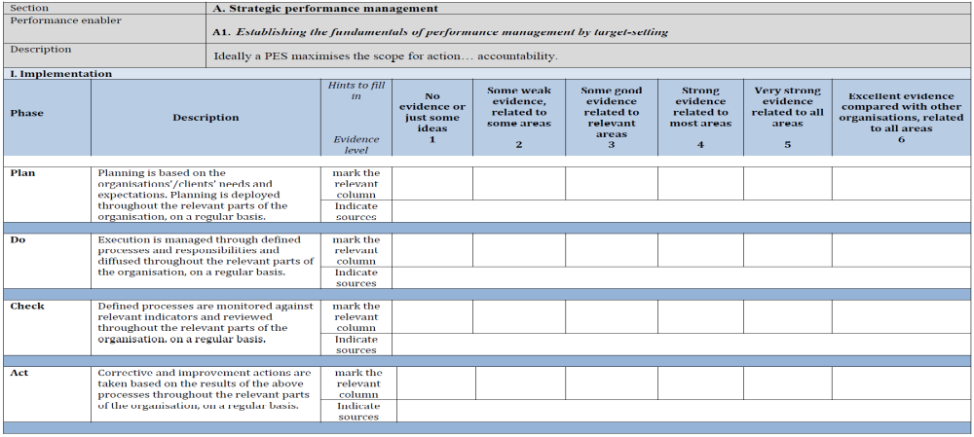
assessment template

Slide 19
Self-assessment and external assessment
Self-assessment (September – November 2017):
  Host PES scores itself on a 6-level scale for each enabler;
  Scoring is done on the basis of available evidence that a PES has implemented organizational solutions according to the definition of excellence (“ideally”);
  The more evidence is available and the more convincing it is, the higher is the score.
External assessment (November – December 2017):
  Discussion on results of self-assessment with representatives of host PES;
  Assessment of evidence presented by host PES;
  Identification of room for improvement together with host PES;
  Scoring of presented evidence.

Slide 20
ESAP work programme 2018-2019
Fully fledged online platform used by beneficiaries
Peer review on employment policy calendar
Informal employment
Benchlearning
Continuous technical assistance

Slide 21
2. Peer review workshops calendar
 | Peer review topic | Date
Albania | On the job training programmes for youth with no qualifications | Fall 2018
BiH | Local employment partnerships | Fall 2018
Kosovo* | Self-employment programmes | 11-12 April 2018
Montenegro | Youth employment | May 2018
Serbia | Employment of persons with disabilities | 19-20 April 2018
The Former Yugoslav Republic of Macedonia | Internship programme | Fall 2018

Slide 22
3. Learning exchange on informal employment
Review and assess in-depth direct and indirect policy approaches and related institutional set-ups and identify needs and barriers to formalization;
Create policy recommendations and produce rapid appraisal of applicability and transferability of best EU policies to the WB6 economies.

Slide 23
4. Benchlearning
Follow-up on the benchlearning assessment
  Strengths
  Areas for further development
  Potential good practices
  Recommendations

Slide 24
Preliminary benchlearning findings
 | Strengths
Albania | Strategic management and target-setting, use of new service model, integration of PES register with other databases, autonomy of regional offices for partnerships
BiH | HR, standardized counselling process, mobile offices, local partnerships for employment
Kosovo* | EMIS, Holistic profiling, Early intervention, Automatic matching
Montenegro | HR, well defined operational processes, well-developed ICT system
Serbia | Standardized business processes, ICT system,
The Former Yugoslav Republic of Macedonia | HR, division of responsibilities, rich databases, good cooperation with local level actors

Slide 25
Preliminary benchlearning findings
 | Areas for further development
Albania | HR strategy, monitoring and evaluation, employer strategy
BiH | Fragmented operational processes, quality management system
Kosovo* | Distribution and evaluation of measures, a strategy for employers
Montenegro | Evaluation of activities and measures, blended services, budget constraints
Serbia | Strengthen analytical function, better targetting, multi-channel services
The Former Yugoslav Republic of Macedonia | Administrative cost of active measures is high, unit for employers, staff motivation

Slide 26
Benchlearning follow-up activities
National action plans
Promotion of good practices/Mutual learning events/study visits
Technical assistance

Slide 27
What about the future?
SEE 2020
Multi-Annual Action Plan on Regional Economic Area
National strategic sectoral documents
ERPs/ESRP

Slide 28
National Strategic Sectoral Documents
1) General growth friendly policies, including business climate improvements;
2) Reform of labour market institutions and legislation (employment protection legislation, wage bargaining, minimum wage setting, promotion of flexicurity principle etc.);
3) Improving knowledge, skills and competencies of the labour force;
4) Improving and expanding active labour market policies; and
5) Promoting social inclusion and addressing poverty through social protection and activation aimed at vulnerable groups.

Slide 29
Reflection on the Economic Reform Programmes 2018
Inspired by the European semester process at EU level, the European Union has introduced a new approach to economic governance in the enlargement agenda;
Since 2015, Western Balkan economies have been invited to improve economic policies and economic governance through the preparation of ERPs;
Includes medium-term macroeconomic and fiscal framework, as well as the sectoral structural reforms for promoting both competitiveness and growth.

Slide 30
ERP 2018 Employment and Labour Market Priorities (cont.)
 | LM challenges | Priority reform plan
Albania | Youth and women inactivity, long term unemployment, low productivity jobs | Modernise public employment services, increase employment of women, youth and vulnerable people
BiH | High unemployment, especially among youth, low activity, skills mismatches, informal employment | Increase labour market efficiency Reform the Employment Service
Kosovo* | High unemployment and inactivity rate, youth, low economic development, supply side constraints | Increasing the access of young people and women to the labour market through the provision of quality employment services, active employment measures and entrepreneurship

Slide 31
ERP 2018 Employment and Labour Market Priorities
 | LM challenges | Priority reform plan
Montenegro | Low activity and employment, informality | Implementing legal provisions in the field of the labour market with focus on active employment policy
Serbia | Youth, long term unemployment, informality, capacity of PES | Improving the effectiveness of active labour market policies with special emphasis on youth, redundant workers and the long term unemployed
The former Yugoslav Republic of Macedonia | Youth, women and LT unemployed; low activity rate; low demand, skill mismatch | Upgrading the active measures included in the Operational Plan for Active Employment Programs and Measures and Labour Market Services

Slide 32
How could ESAP evolve?
Employment policies (priority axes: activation, youth and long term unemployed, informal employment)
Benchlearning
Technical Assistance
Establish closer links with EU wide structures (EU PES network, European Platform Against Undeclared Work, EURES network, joint mutual learning events)

Slide 33
Thank you for your attention!

